Slide 1







Playing with Tiny bit
Musical rhythm
Yahboom

Slide 2









Contents
Preparation
Learning goal
Search for blocks
Combine blocks
Experimental phenomena
Yahboom

Slide 3

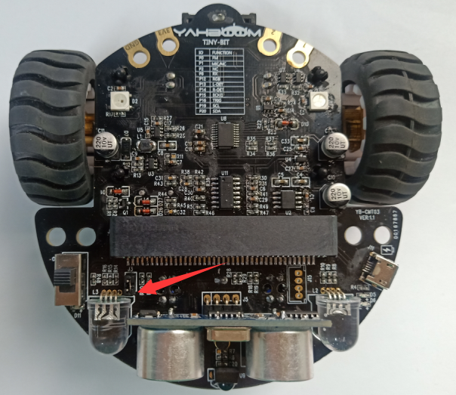
Preparation
The position of the Voice sensor module in the robot
! ! ! Note:
In this experiment, we need to install the jumper cap in the position shown below.
Yahboom

Slide 4
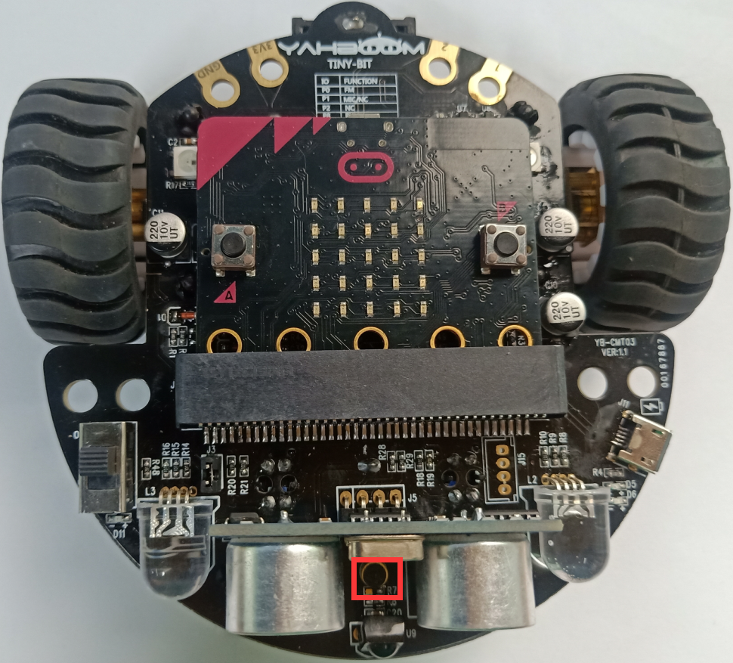
Preparation
In the picture shown below, the voice sensor module with red wire frame.
Yahboom

Slide 5
Preparation
Programming method:
Mode 1 online programming: First, we need to connect the micro:bit to the computer by USB cable. The computer will pop up a USB flash drive and click on the URL in the USB flash drive: http://microbit.org/ to enter the programming interface. Add the Yahboom package: https://github.com/YahboomTechnology/Tiny-bitLib to program.
Mode 2 offline programming: We need to open the offline programming software. After the installation is complete, enter the programming interface, click【New Project】, add Yahboom package: https://github.com/YahboomTechnology/Tiny-bitLib, you can program.
Yahboom

Slide 6
Learning goal
1.Learn how to use voice sensor return graphically program building blocks and RGB searching lights graphically program building blocks
2.The function is realized by programming: When the sound sensor detects sounds of different intensities, the lights of robot car will switch color and brightness, and the micro:bit dot matrix displays different patterns.
Yahboom

Slide 7

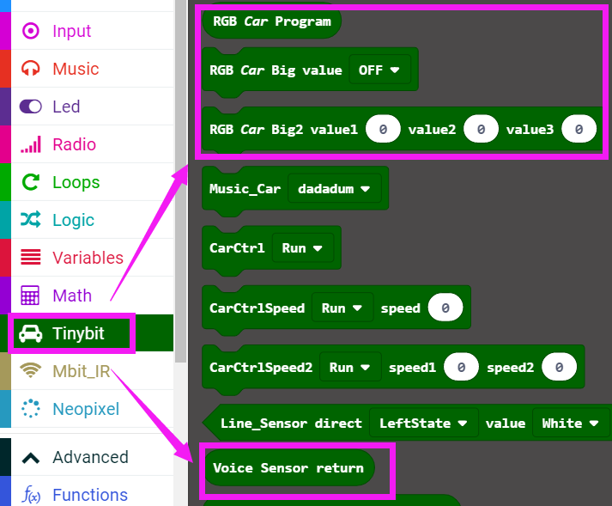
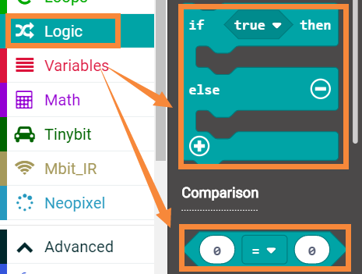
Search for block
The following is the location of the building blocks required for this programming.
Yahboom

Slide 8
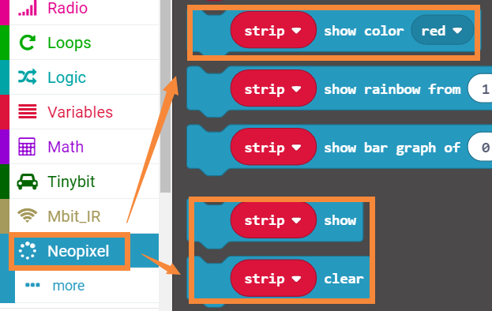
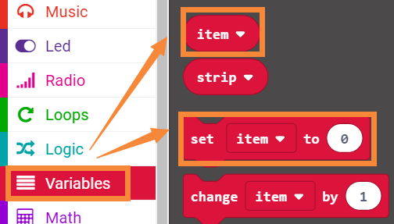
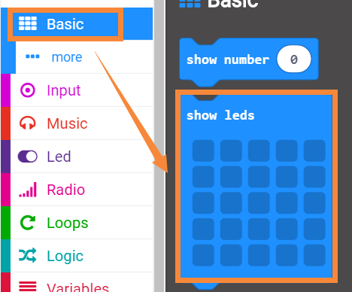
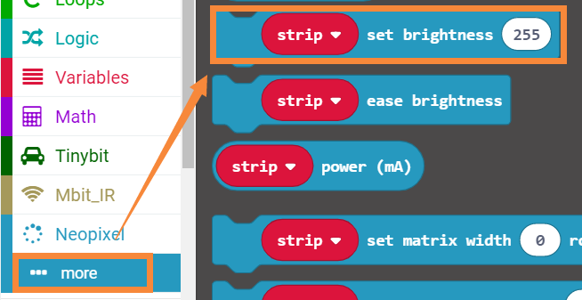
Search for block
Yahboom

Slide 9
Combine block
The summary program is microbit-Musical-rhythm.hex
Yahboom

Slide 10
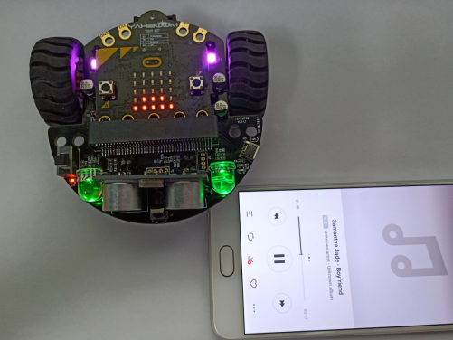
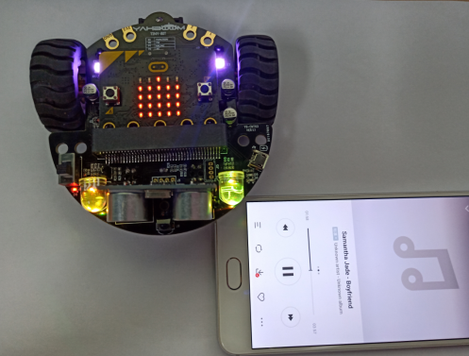
Experimental phenomena
After the program is downloaded, open the power of the car. When the sound sensor detects sounds of different intensities, the lights of robot car will switch color and brightness, and the micro:bit dot matrix displays different patterns.
Yahboom

Slide 11
Inspire Creativity Embrace Innovation
Thank you!!!

